Slide 1
PRESENTATION
ON
HOUSE PRICE PREDICTION
Submitted to: Submitted by:
Flip Robo Technologies Priya Rajput

Slide 2
INTRODUCTION
Business Problem Framing
Conceptual Background Of Domain Knowledge
Problem Statement
ANALYTICAL PROBLEM FRAMING
EXPLORATORY DATA ANALYSIS
CONCLUSION WITH FUTURE SCOPE

Slide 3
Housing Price
Houses are one of the necessary needs of each and every person around the globe and therefore housing and real estate market is one of the markets which is one of the major contributors in the world’s economy.
Housing prices are an important reflection of the economy, and housing price ranges are of great interest for both buyers and sellers

Slide 4

The goal of this project is to create a regression model that is able to accurately estimate the price of the house given the features.
This model can be useful for potential buyers in deciding the characteristics of a house they wantthat best fits their budget and will be of tremendous benefit, especially to housing developers and researchers, to ascertain the most significant attributes to determine house prices and to acknowledge the best machine learning model to be used to conduct a study in this field.

Slide 5
CONCEPTUAL BACKGROUND OF THE DOMAIN PROBLEM
Check whether the problem is supervised or not.
Check whether model is regression or classification type.
Perform various mathematical and statistical analysis which include description or statistical
summary of the data, correlation using corr() and data visualization . Then we have used zscore to plot outliers and remove them.
Check whether our dataset is balanced or imbalanced. If data is imbalanced, then we apply sampling techniques to balance the dataset.
Building the model and check its accuracy.
Selecting the model, hyperparameter tuning would be done.

Slide 6
Problem Statement
The objective behind to make this project is to contribute to the world’s economy. Houses are one of the necessary need of each and every person around the globe and therefore housing and real estate market is one of the markets which is one of the major contributors in the world’s economy.

Slide 7
import numpy as np
import pandas as pd
import matplotlib.pyplot as plt
import seaborn as sns

Slide 8
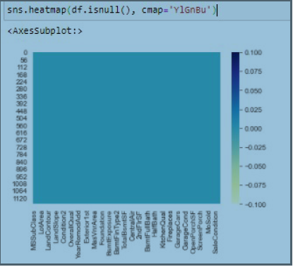
Null values
There is many null values in the dataset

Slide 9

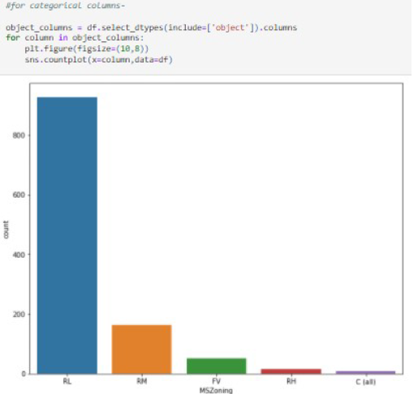
Feature: Mszoning
Observation: Number count for IR is highest as compared to others

Slide 10
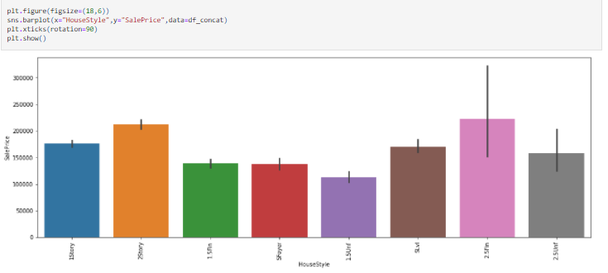
Bivariate Analysis
Feature: House Style
Observation: Two and half is on higher count on sales price as compared to others

Slide 11

Low density residential zoning classification has the highest sale price.
Commercial zoing classification has the lowest sale price.
Medium density residential zoning classification has also high sale prices.
High density residential zoning classification has also low prices.
Pave street has higher sale prices than Gravel street.
Gravel alley has the highest sale price.
Slightly irregular lot shape property has the highest sale prices.
Irregulat lot shape property has the lowest sale prices.
Near Flat/Level land contour has the highest sale prices

Slide 12
Northridge Physical locations within Ames city limits has the highest sale prices.
Northridge Heights, Stone Brook, Old Town, Somerset and Northridge have also high sale prices.
Regions which have Excellent quality of the material on the exterior have the highest sale prices.
Regions which have Fair quality of the material on the exterior have the lowest sale prices.
Regions which have good quality of the material on the exterior also have high sale prices.
Regions which have Average/Typical present condition of the material on the exterior have the highest sale prices.
Regions which have poor present condition of the material on the exterior have the lowest sale prices.
Regions which have good present condition of the material on the exterior have high sale prices.

Slide 13
Interpretation of the Results
Data is correlated with each other and also check correlation with the target variable. For this work, I have used heatmap, barplots.
In the pre-processing part, data cleared in various ways. Firstly, dropped some columns which we feel are not contributing in predicting the target variable. Then we use Label Encoder to encode the object type data because a machine can only read numbers. I also replaced the null values using mean and mode.
In the modeling part, we select our model for hype parameter tuning i.e Gradient Boosting Regressor model and calculate r2score and its mean absolute error

Slide 14
Conclusion
The best algorithm for this project accordingly is Gradient Boosting Regressor because the accuracy that we have achieved is quite satisfactory than the other models.

Slide 15
Thank You

